Slide 1
CSE 445 Lecture 13
Decision Tree (part 2)

Slide 2
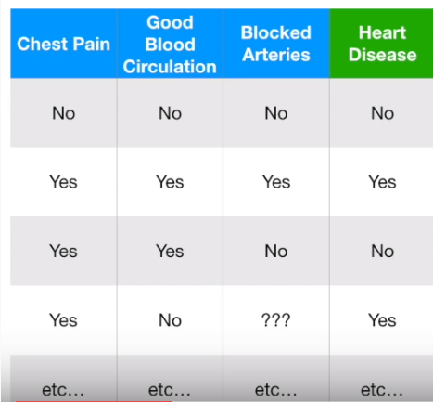
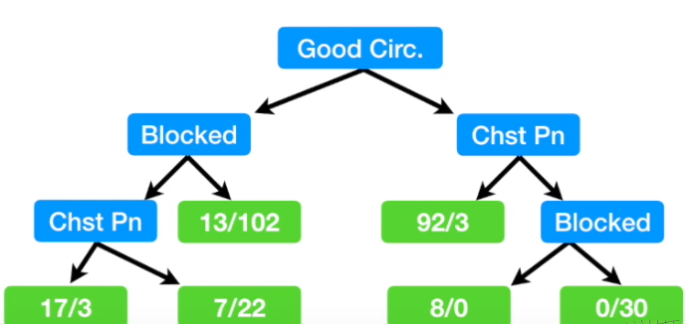
Feature selection

Slide 3
Feature selection
We use impurity to decide if a feature is important
Larger impurity means the feature is not good
Gives hints about the importance of the feature for classification
We can set a threshold for keeping a feature
Thus we can use decision tree for selecting features

Slide 4
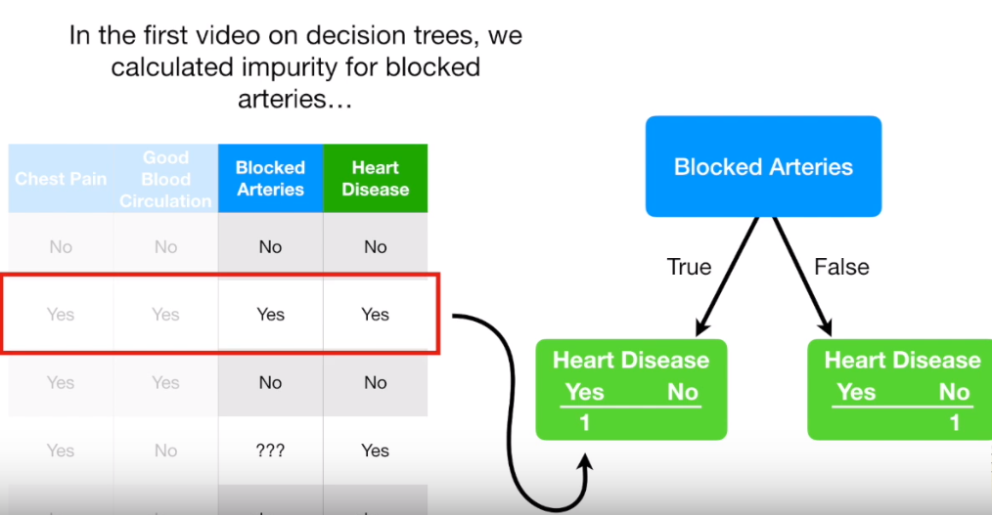
Dealing with missing values

Slide 5
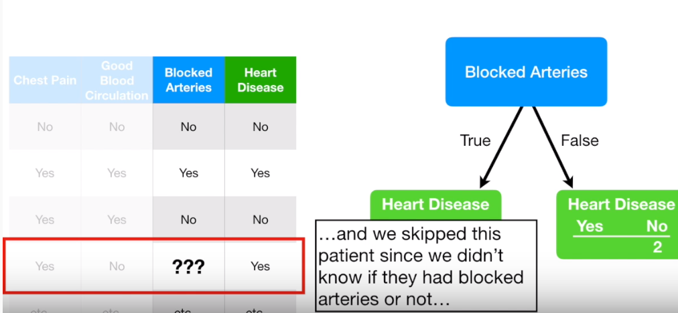
Dealing with missing values

Slide 6
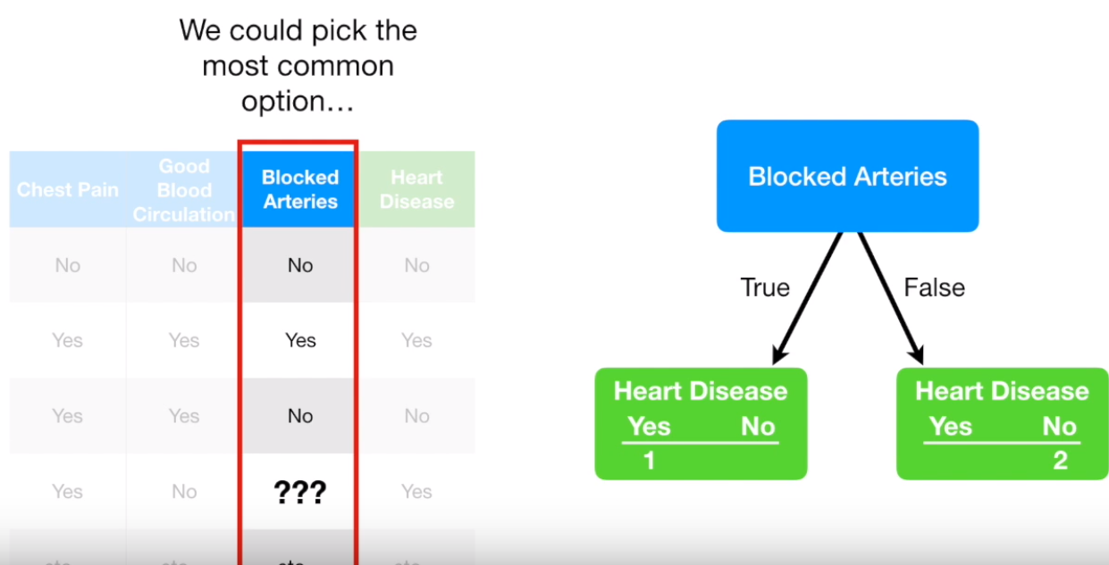
Dealing with missing values

Slide 7
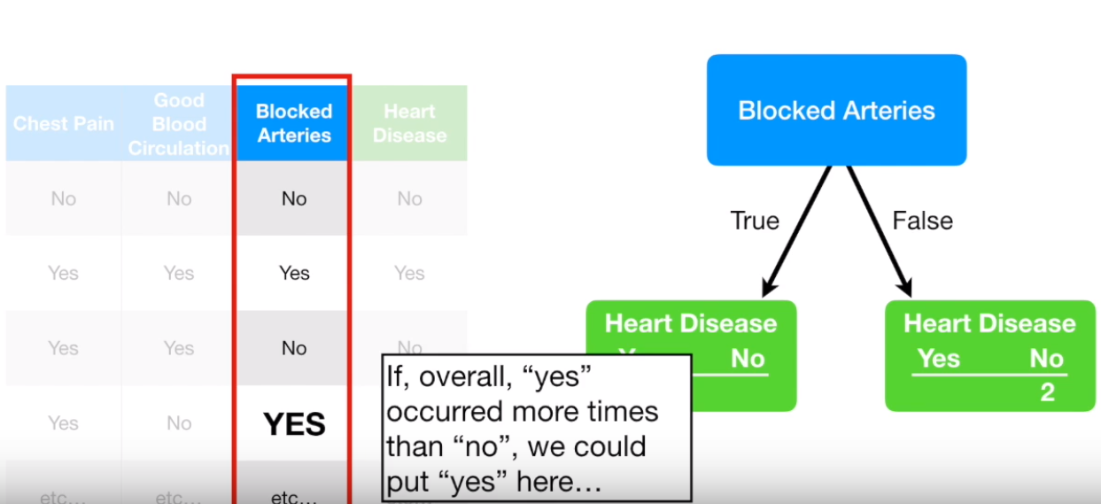
Dealing with missing values

Slide 8
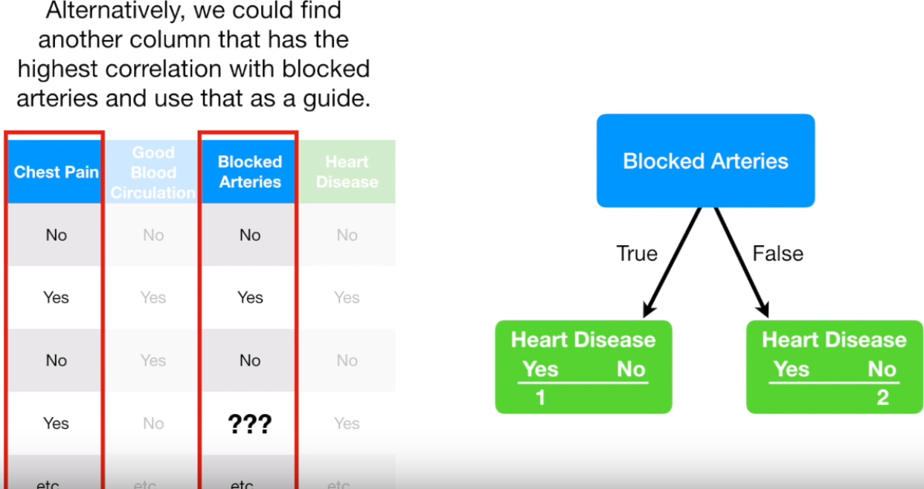

Slide 9
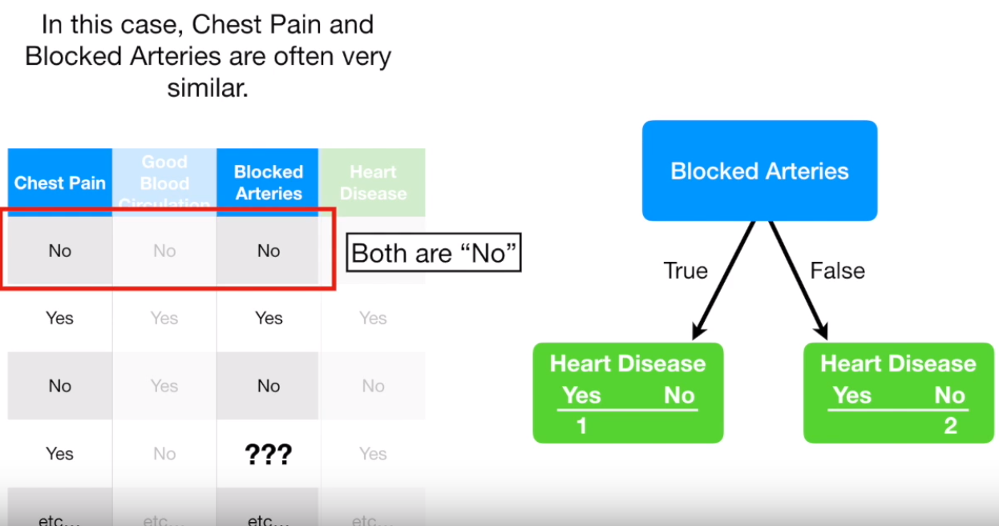
Dealing with missing values

Slide 10
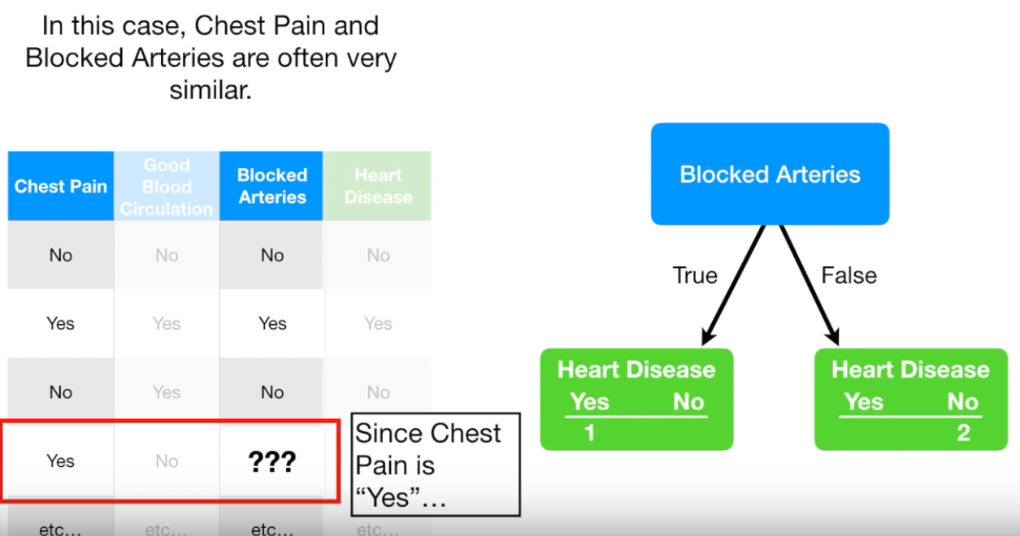
Dealing with missing values

Slide 11
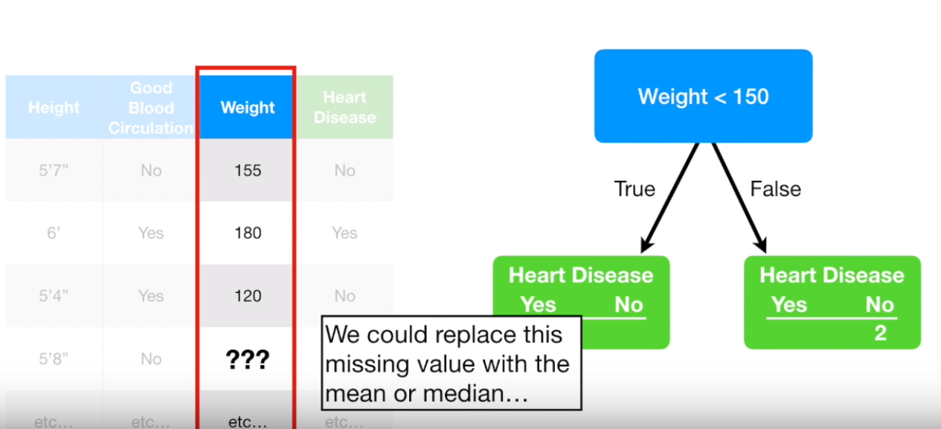
Dealing with missing values

Slide 12
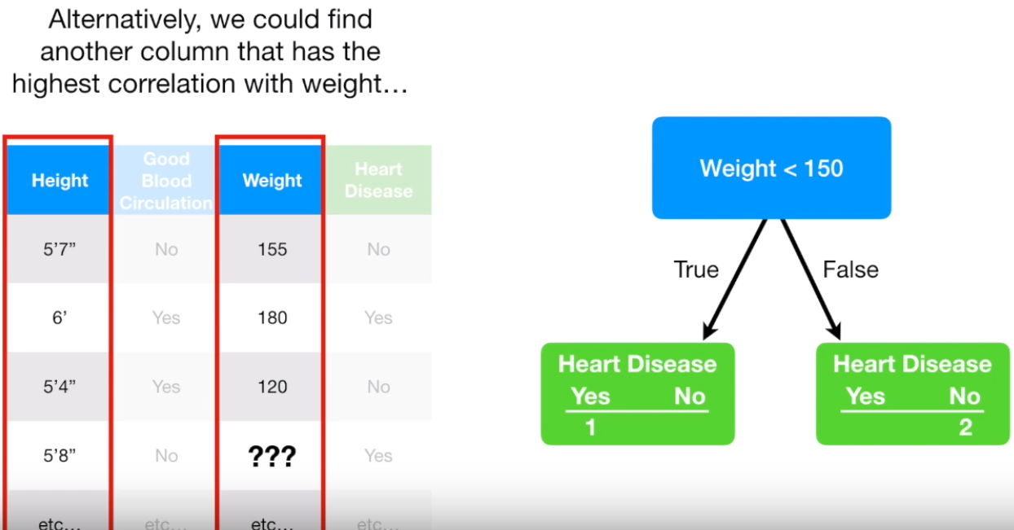
Dealing with missing values

Slide 13
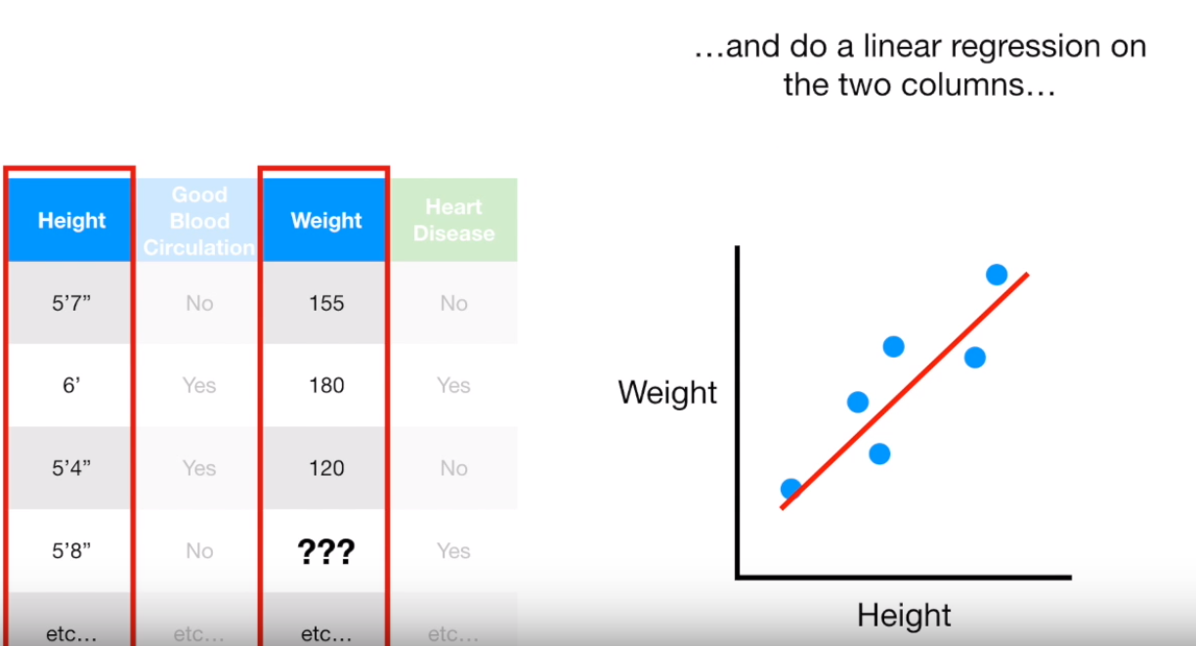
Dealing with missing values

Slide 14
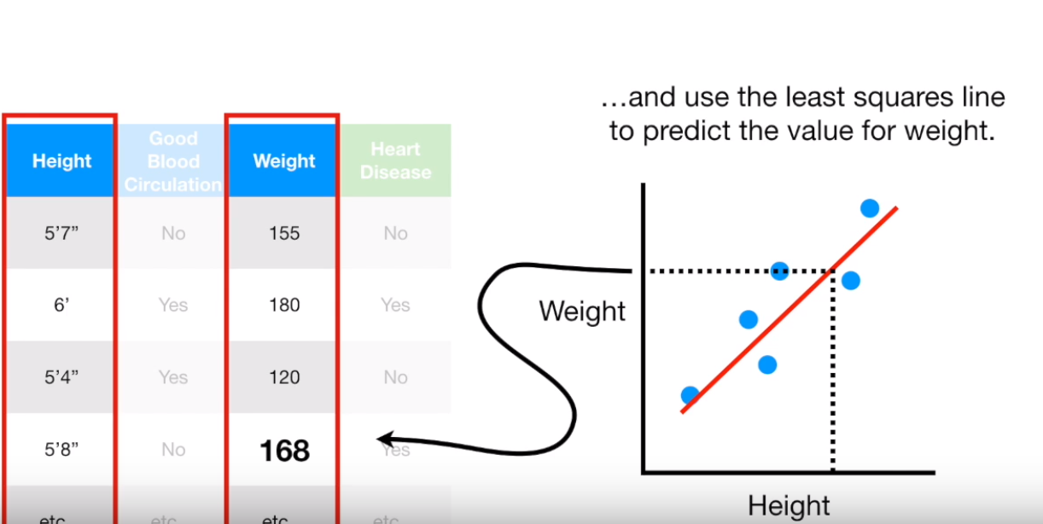
Dealing with missing values

Slide 15
CART Algorithm
Scikit-Learn uses the Classification And Regression Tree (CART) algorithm to train Decision Trees
The idea is really quite simple:
The algorithm first splits the training set in two subsets using a single feature k and a threshold T_{k} (e.g., “petal length ≤ 2.45 cm”)
How does it choose k and T_{k}? (We discussed it in the last class)
It searches for the pair (k, tk) that produces the purest subsets (weighted by their size)
Once it has successfully split the training set in two, it splits the subsets using the same logic, then the sub-subsets and so on, recursively
It stops the recursion once it reaches the maximum depth (defined by the max_depth hyper-parameter), or if it cannot find a split that will reduce impurity

Slide 16
Complexity of the algorithm
Suppose we have n examples and m features
Decision Trees are approximately balanced, so traversing the Decision Tree requires going through roughly O(log2(m)) nodes – the height of the tree
So predictions are very fast, even when dealing with large training sets
However, the training algorithm compares all features
This results in a training complexity of O(n × m log(m))
For small training sets (less than a few thousand instances), Scikit-Learn can speed up training by presorting the data (set presort=True), but this slows down training considerably for larger training sets

Slide 17
Regularization
Decision Trees make very few assumptions about the training data (as opposed to linear models, which assume that the data is linear)
If left unconstrained, the tree structure will adapt itself to the training data, fitting it very closely, and most likely overfitting it
The DecisionTreeClassifier class has a few parameters that similarly restrict the shape of the Decision Tree:
max_depth – maximum depth of the Decision Tree
min_samples_split – the minimum number of samples a node must have before it can be split)
min_samples_leaf – the minimum number of samples a leaf node must have)
min_weight_fraction_leaf – same as min_samples_leaf but expressed as a fraction of the total number of weighted

Slide 18
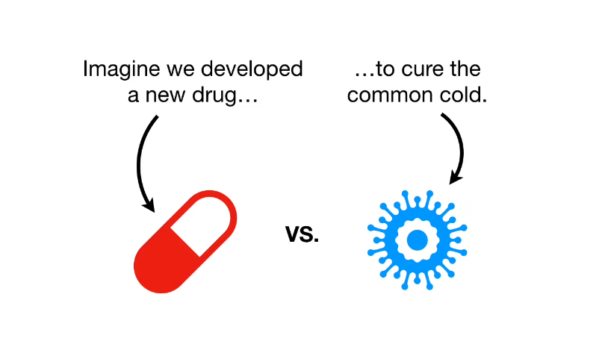
Decision Tree Regression

Slide 19
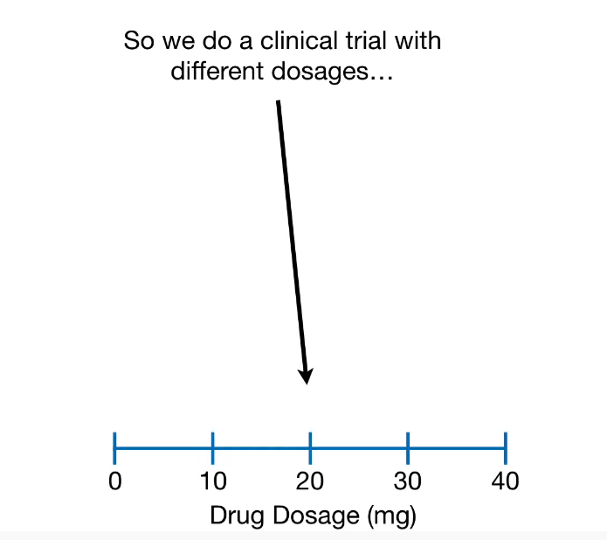
Decision Tree Regression

Slide 20
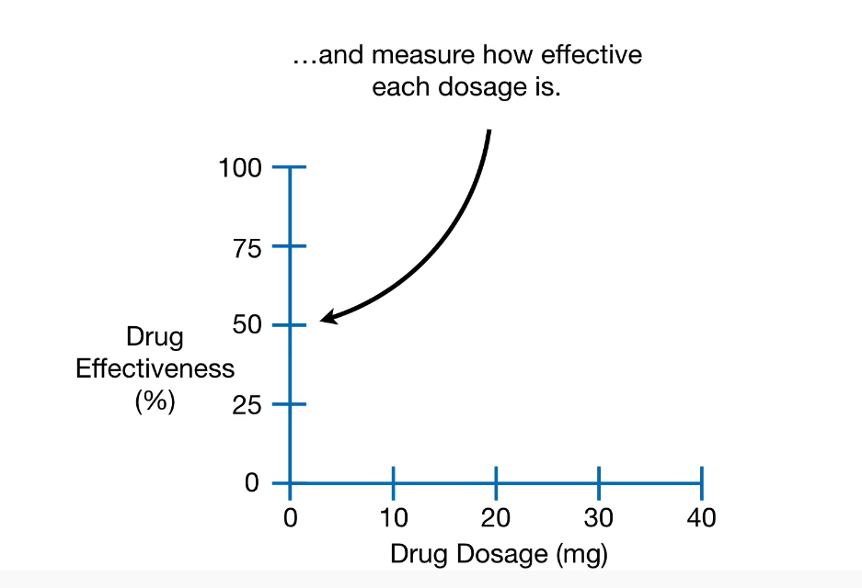
Decision Tree Regression

Slide 21
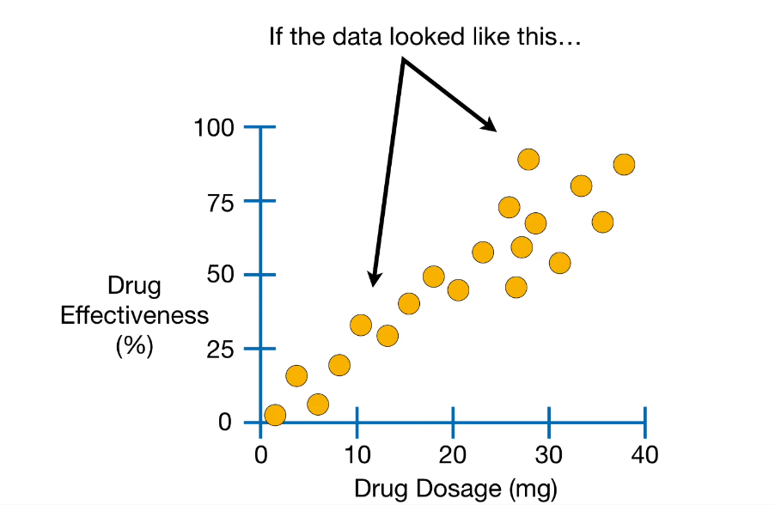
Decision Tree Regression

Slide 22
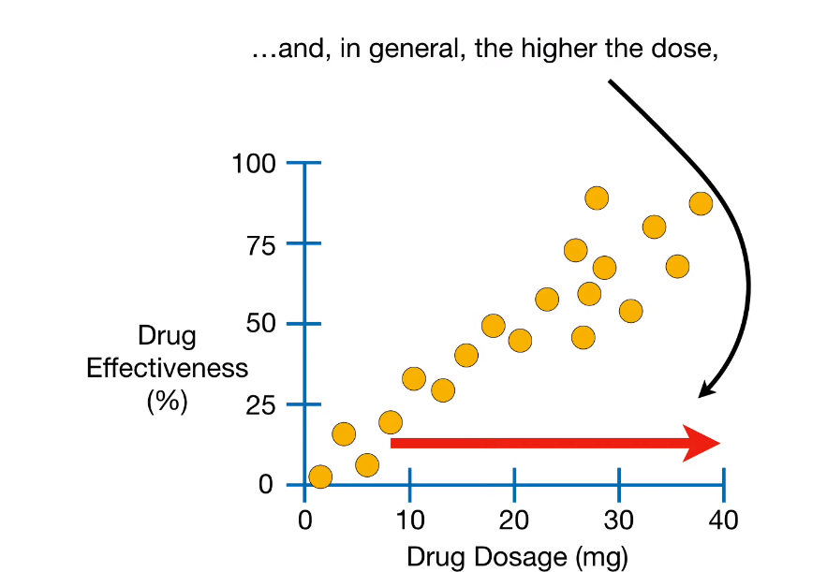
Decision Tree Regression

Slide 23
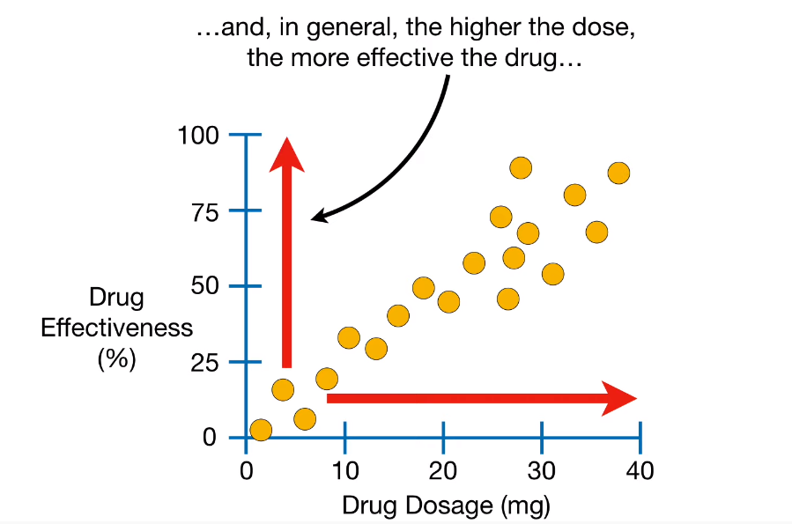
Decision Tree Regression

Slide 24
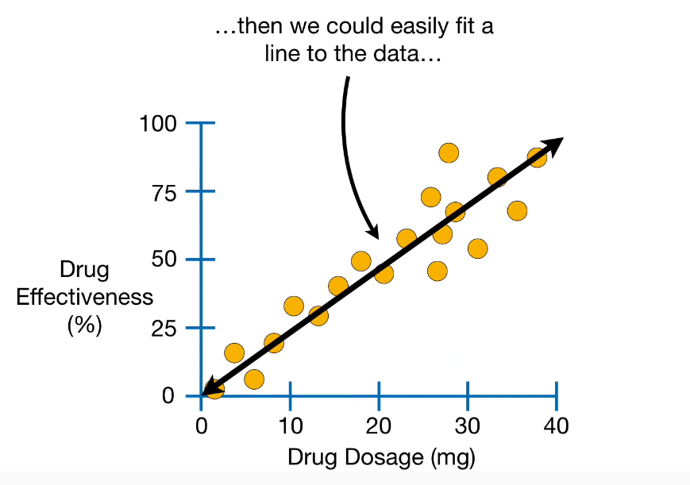
Decision Tree Regression

Slide 25
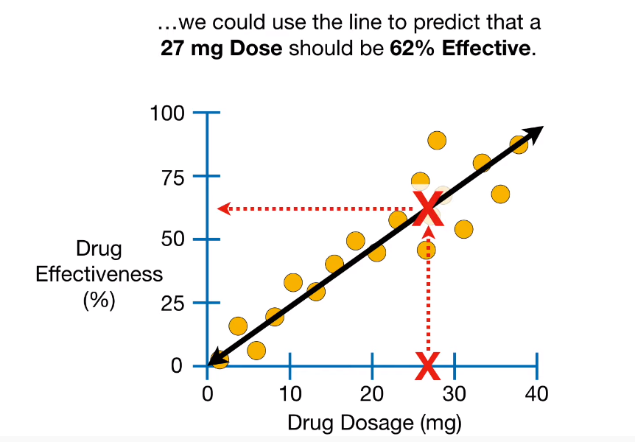
Decision Tree Regression

Slide 26
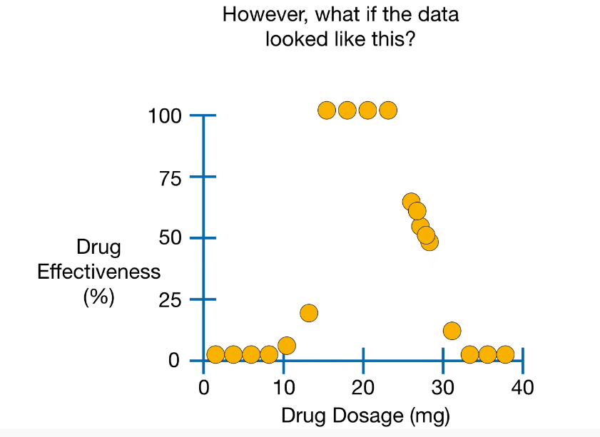
Decision Tree Regression

Slide 27
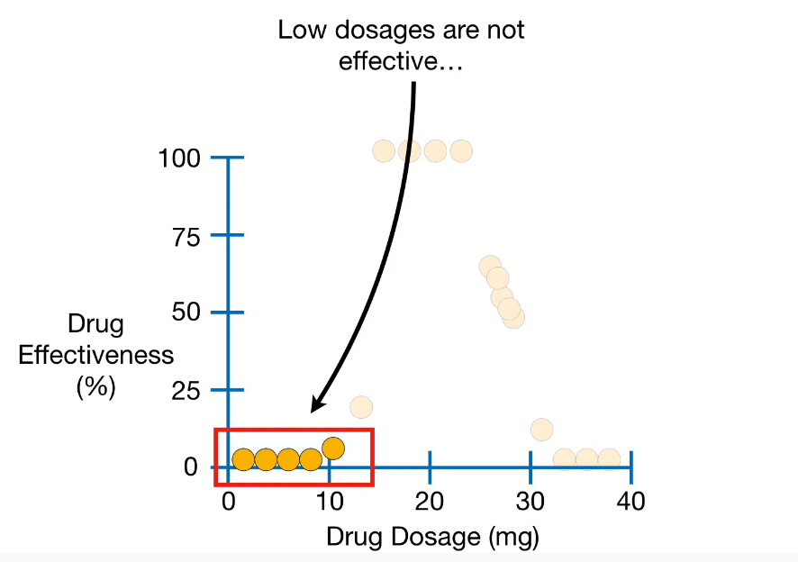
Decision Tree Regression

Slide 28
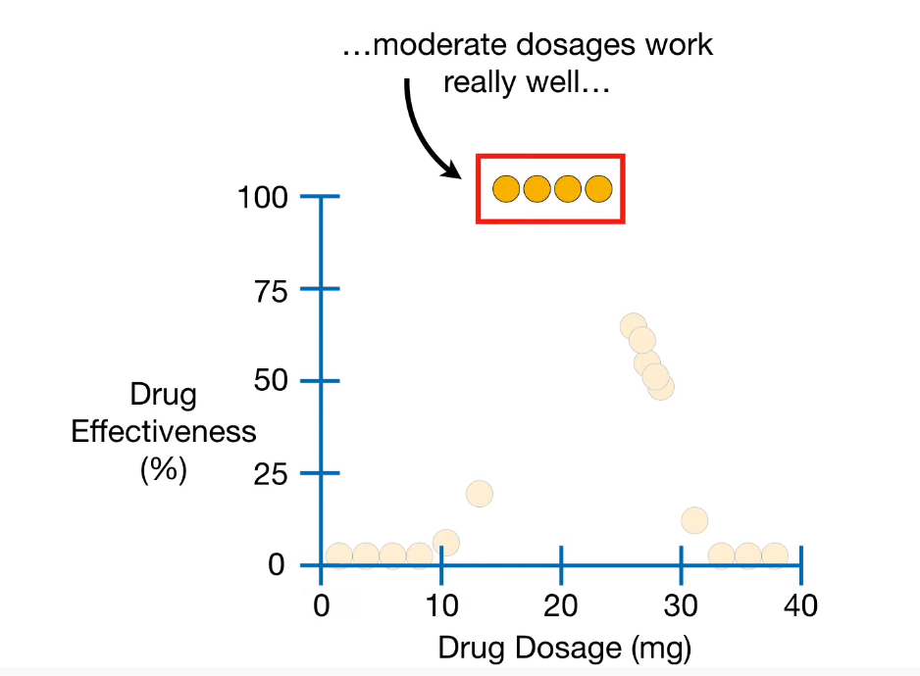
Decision Tree Regression

Slide 29
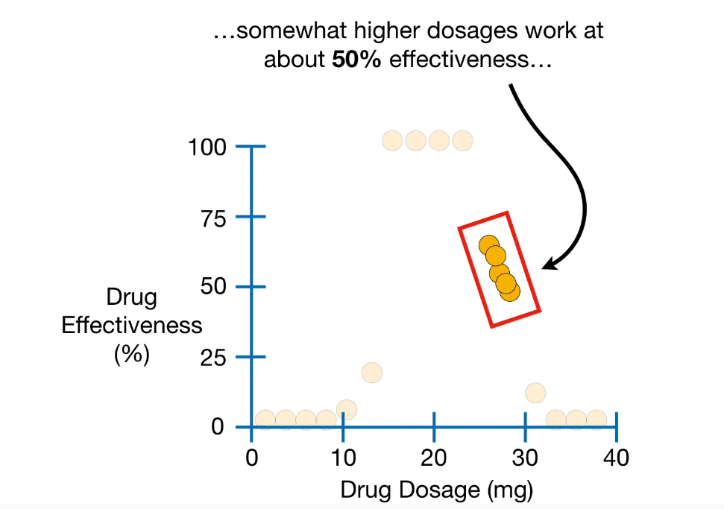
Decision Tree Regression

Slide 30
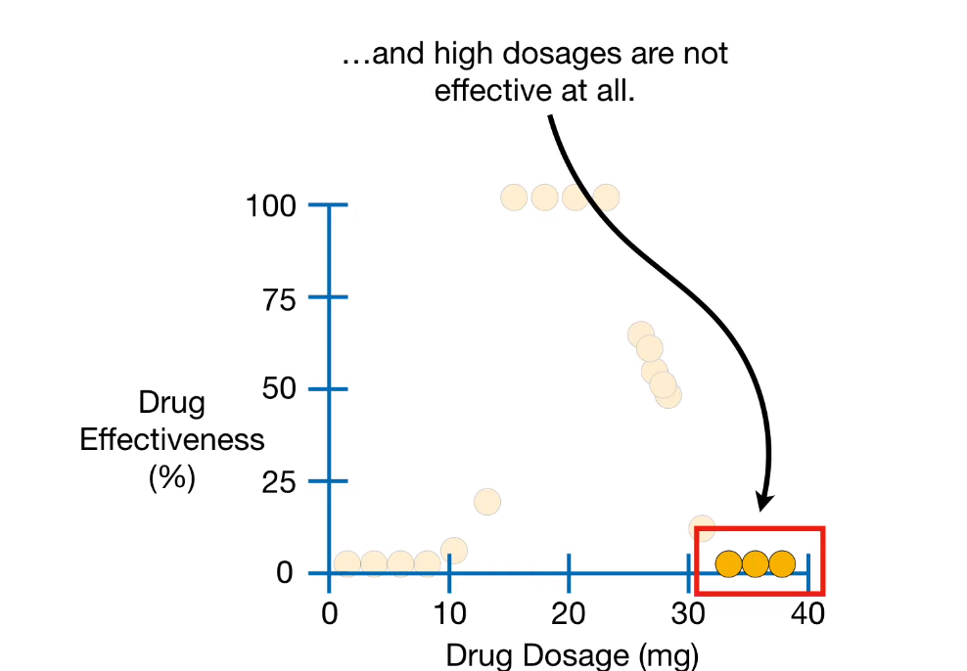
Decision Tree Regression

Slide 31
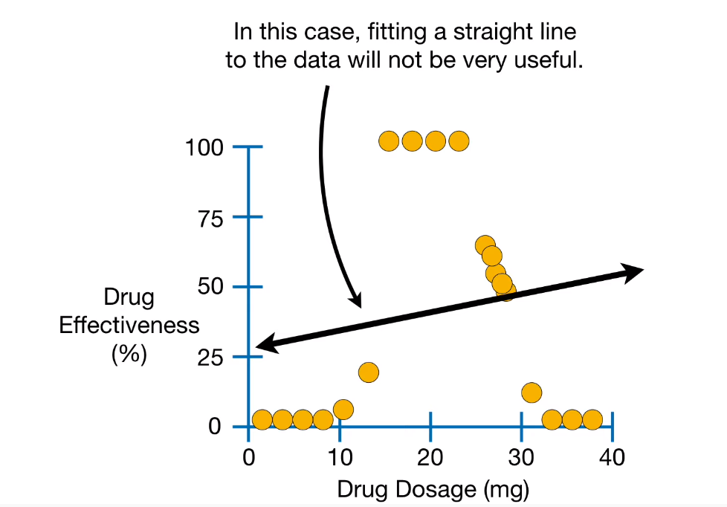
Decision Tree Regression

Slide 32
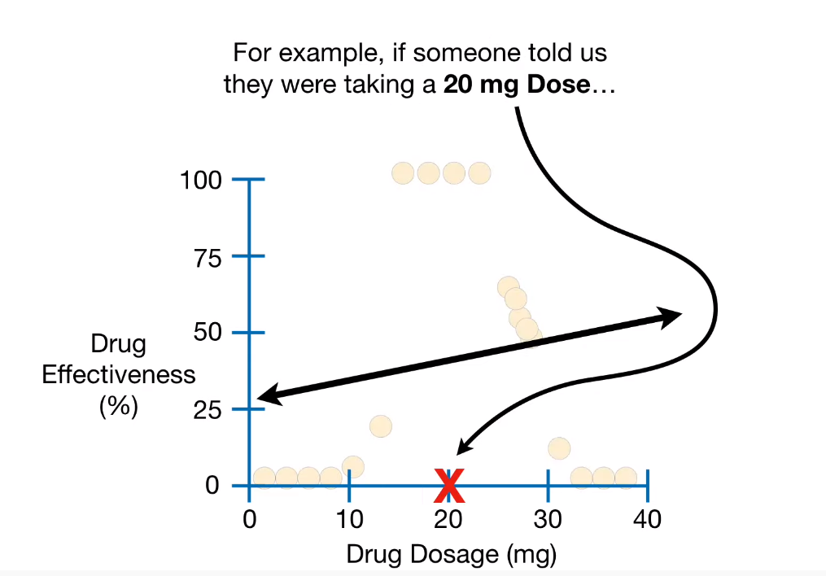
Decision Tree Regression

Slide 33
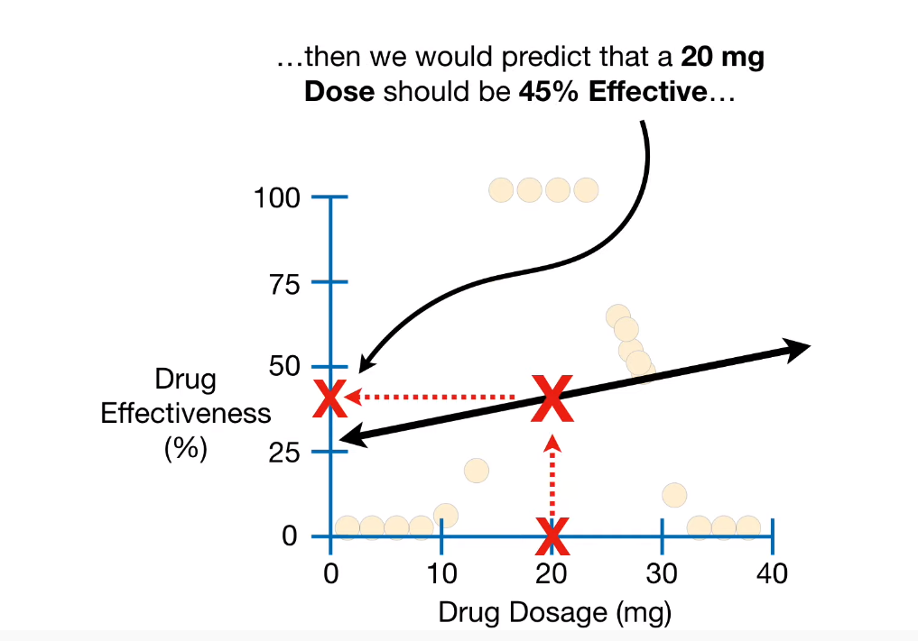
Decision Tree Regression

Slide 34
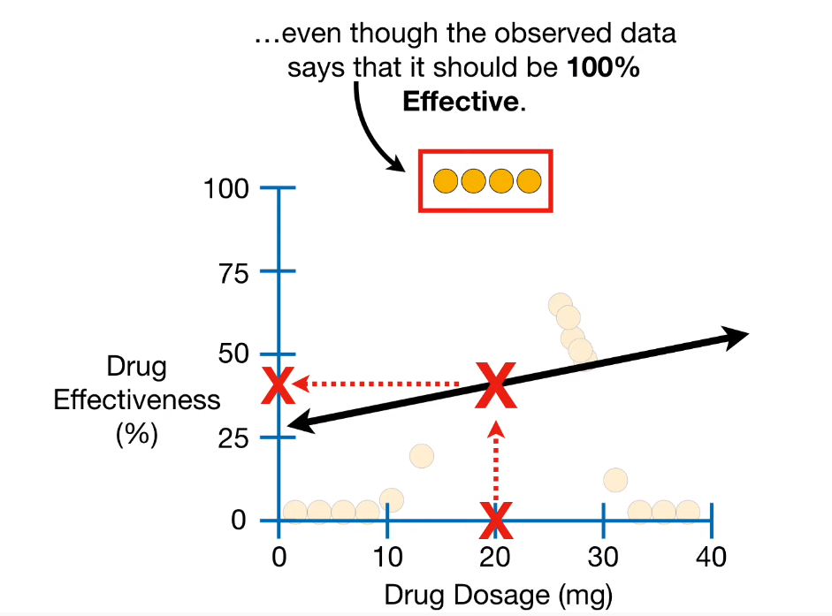
Decision Tree Regression

Slide 35
Decision Tree Regression
What do we do?
Use SVM?
Very expensive for large datasets
Linear Regression?
Inaccurate
Something else?
Lets see…

Slide 36
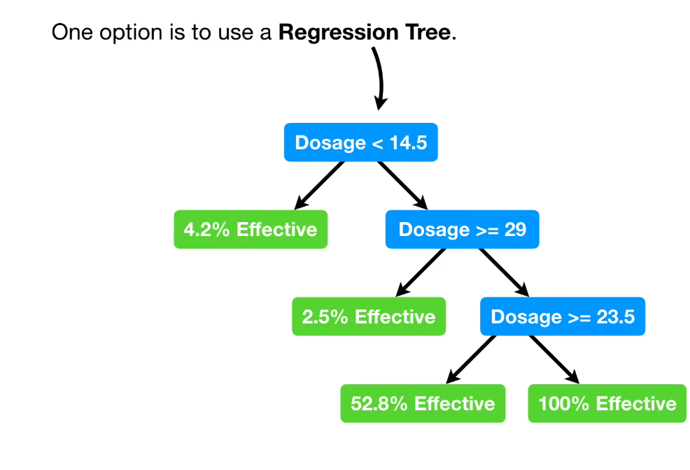
Decision Tree Regression

Slide 37
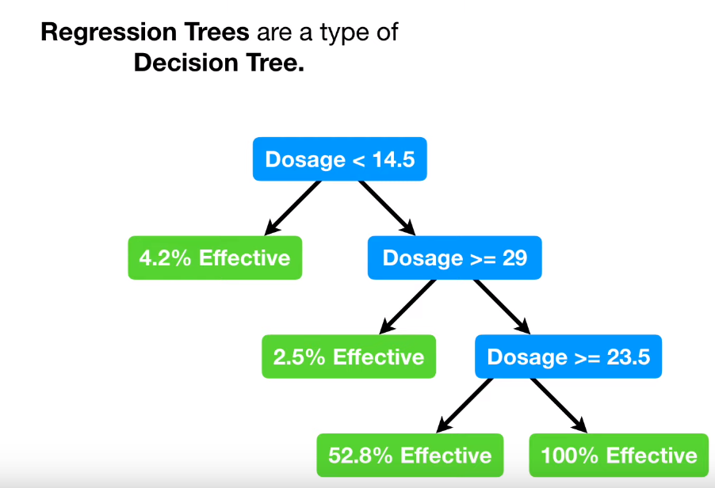
Decision Tree Regression

Slide 38
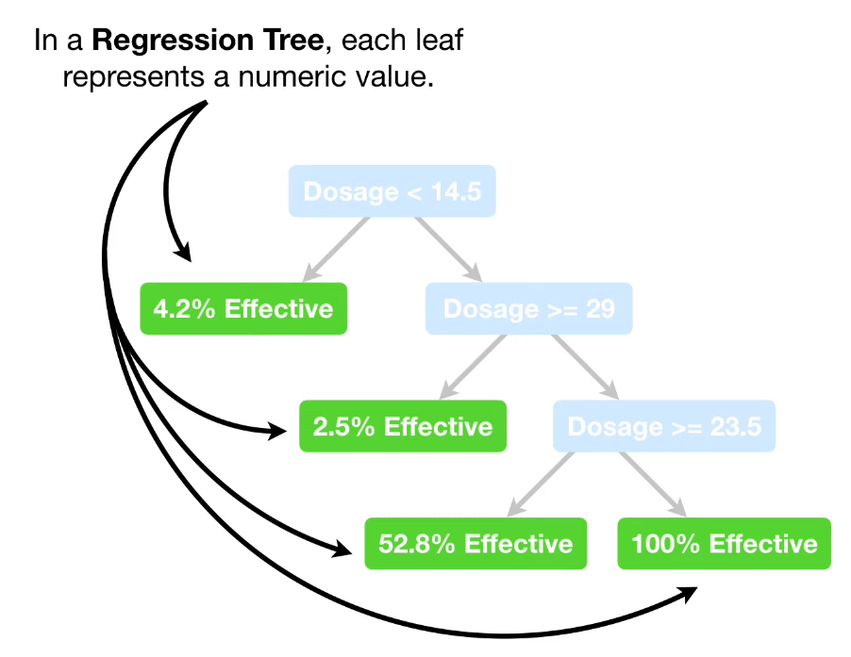
Decision Tree Regression

Slide 39
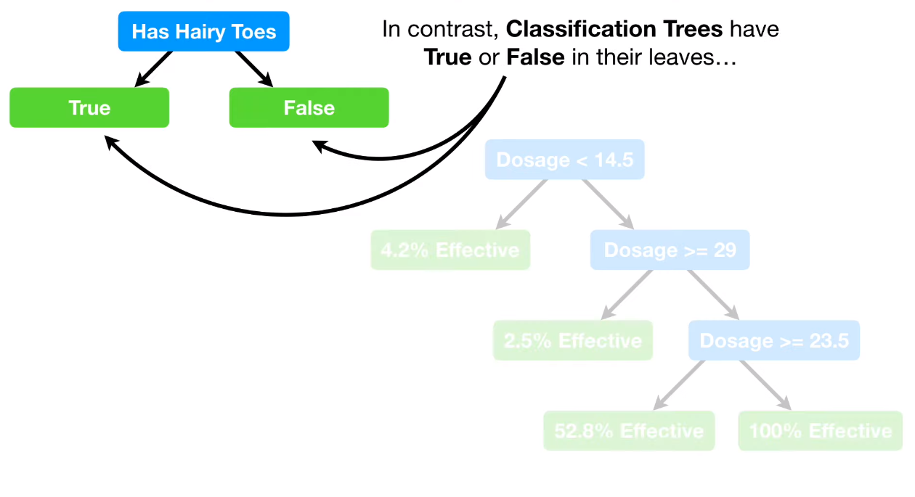
Decision Tree Regression

Slide 40
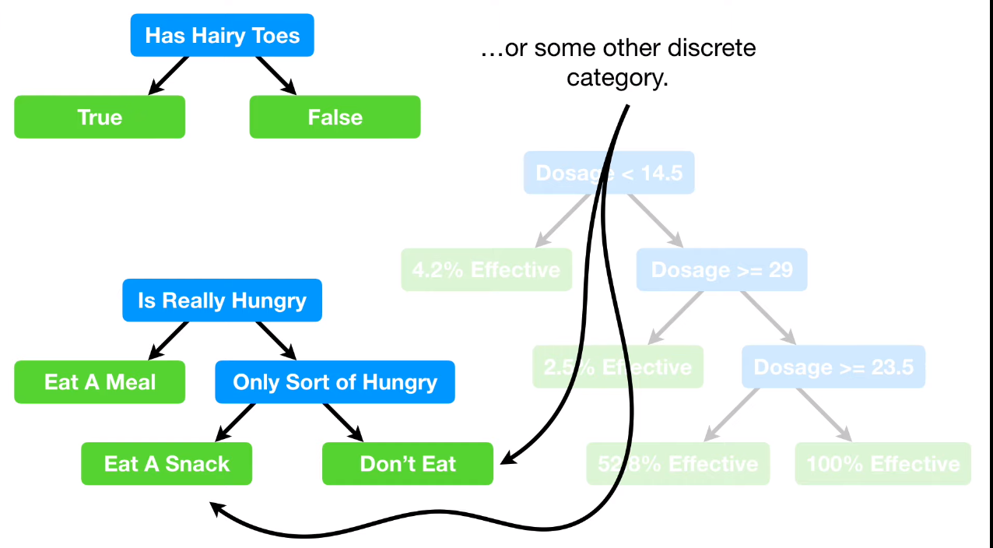
Decision Tree Regression

Slide 41
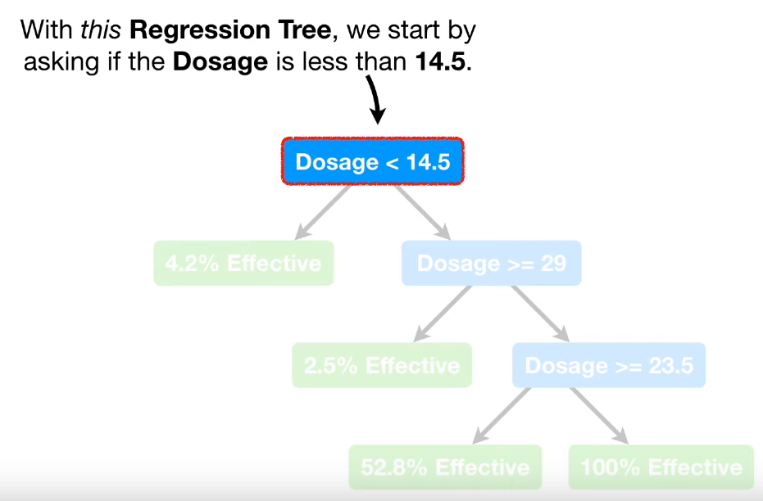
Decision Tree Regression

Slide 42
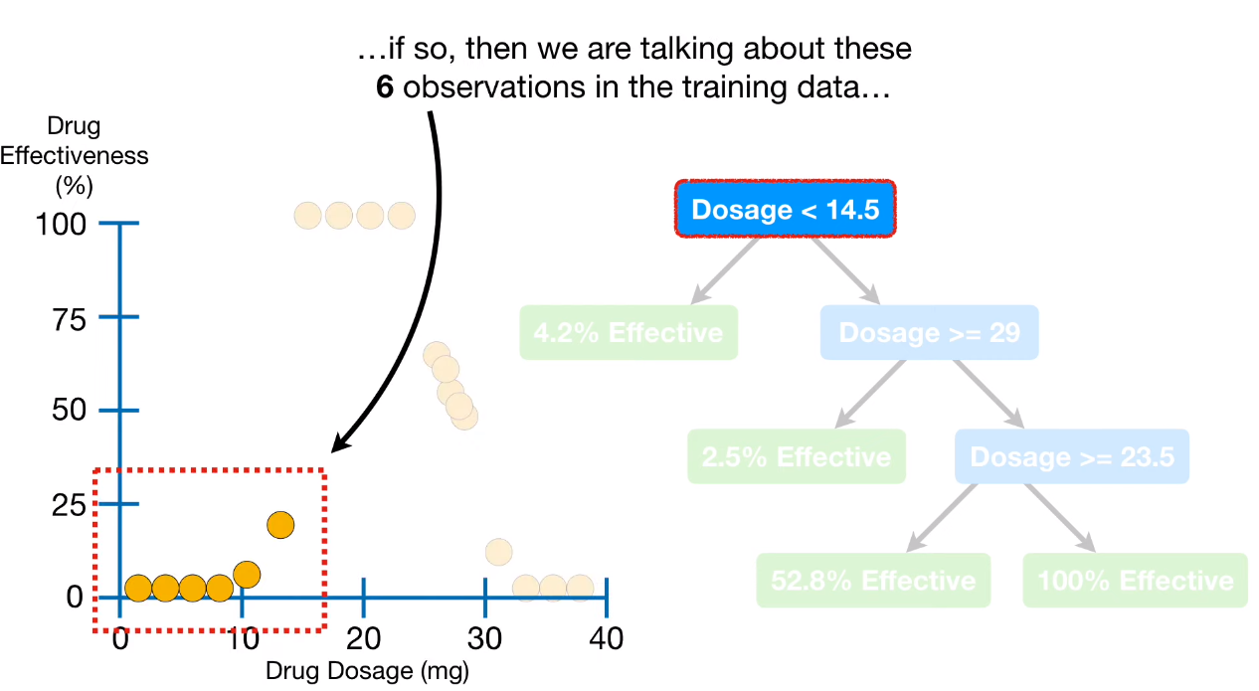
Decision Tree Regression

Slide 43
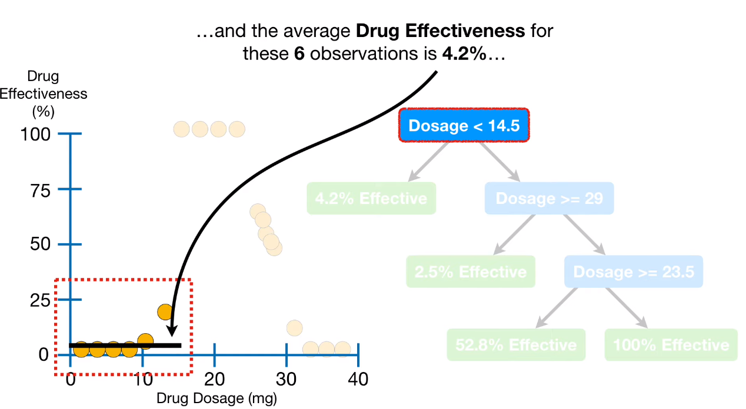
Decision Tree Regression

Slide 44
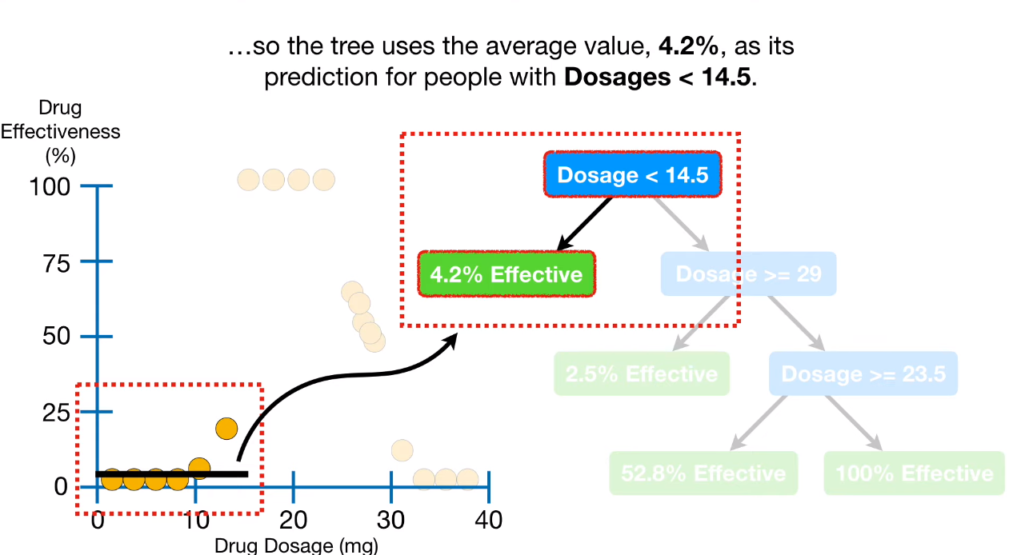
Decision Tree Regression

Slide 45
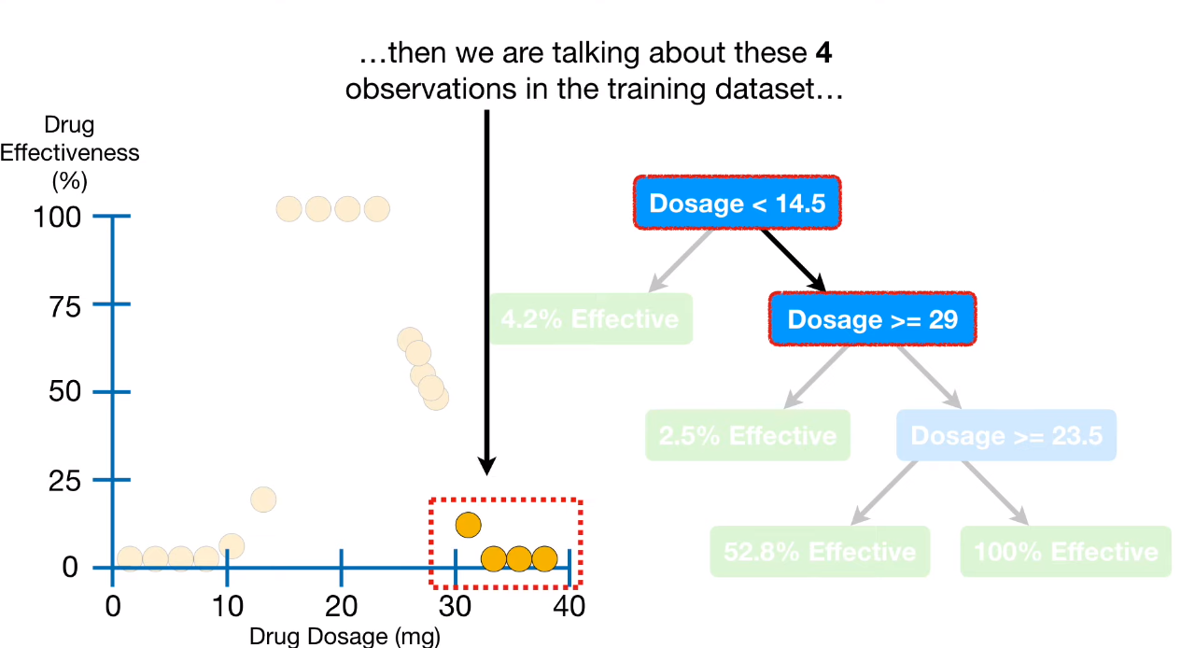
Decision Tree Regression

Slide 46
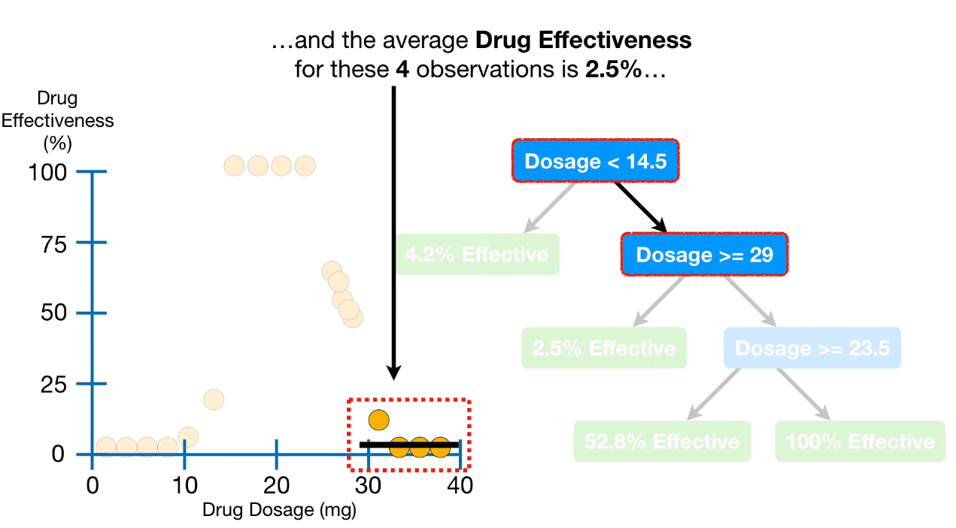
Decision Tree Regression

Slide 47
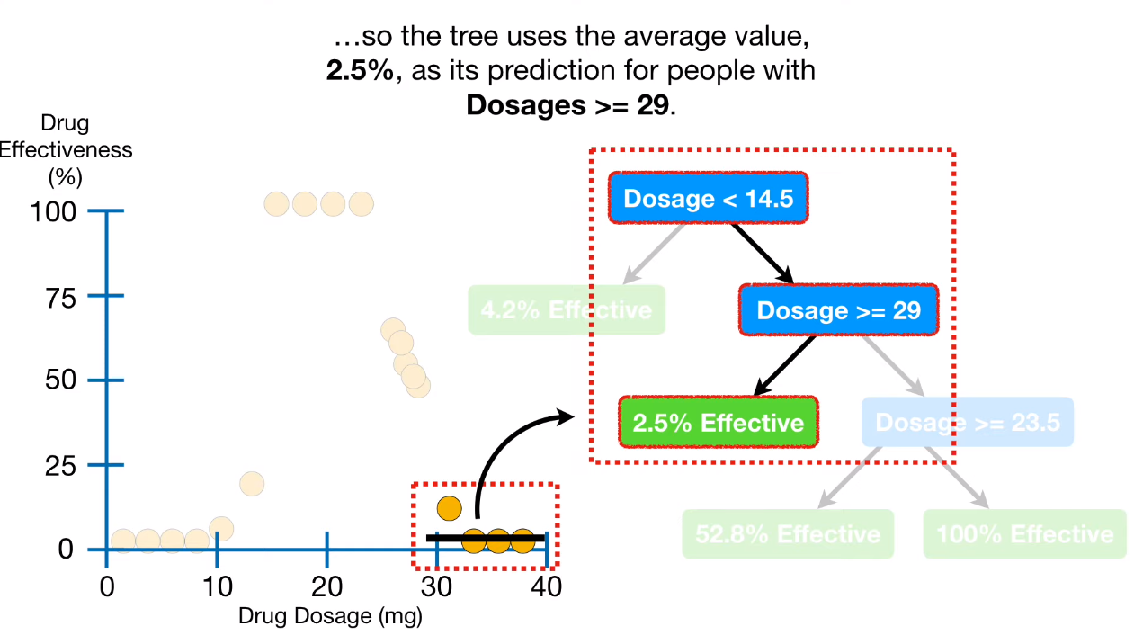
Decision Tree Regression

Slide 48
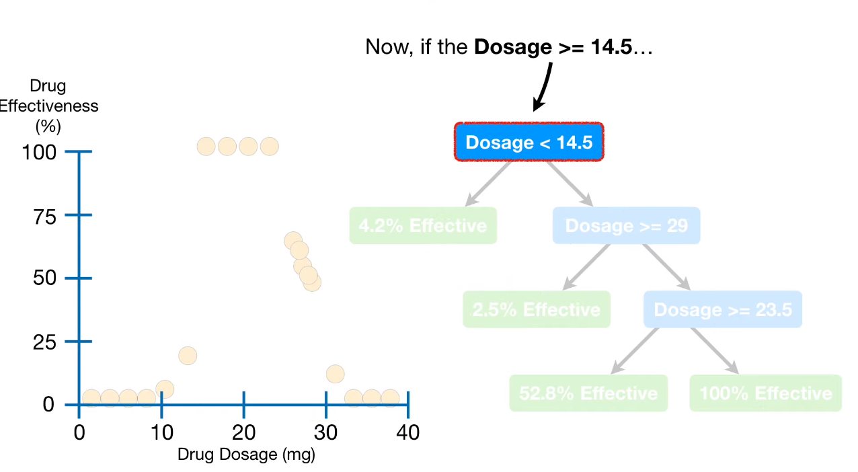
Decision Tree Regression

Slide 49
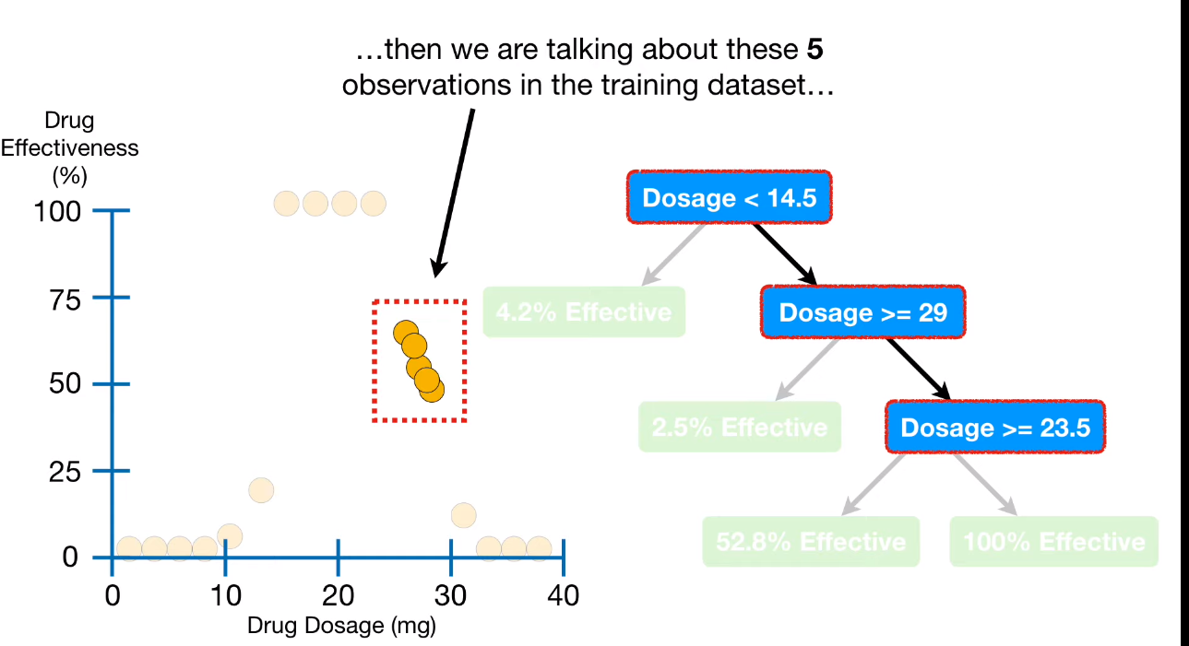
Decision Tree Regression

Slide 50
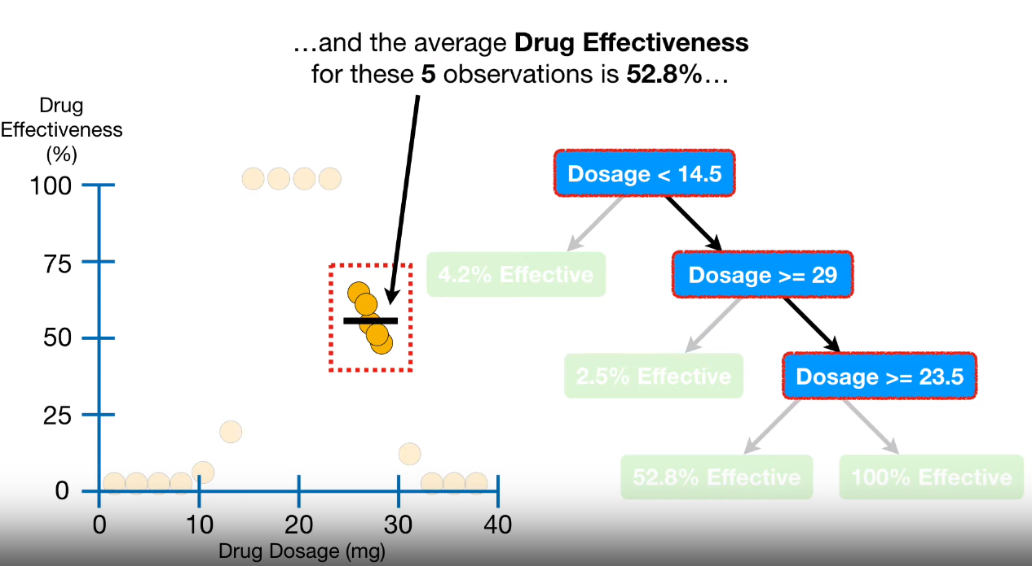
Decision Tree Regression

Slide 51
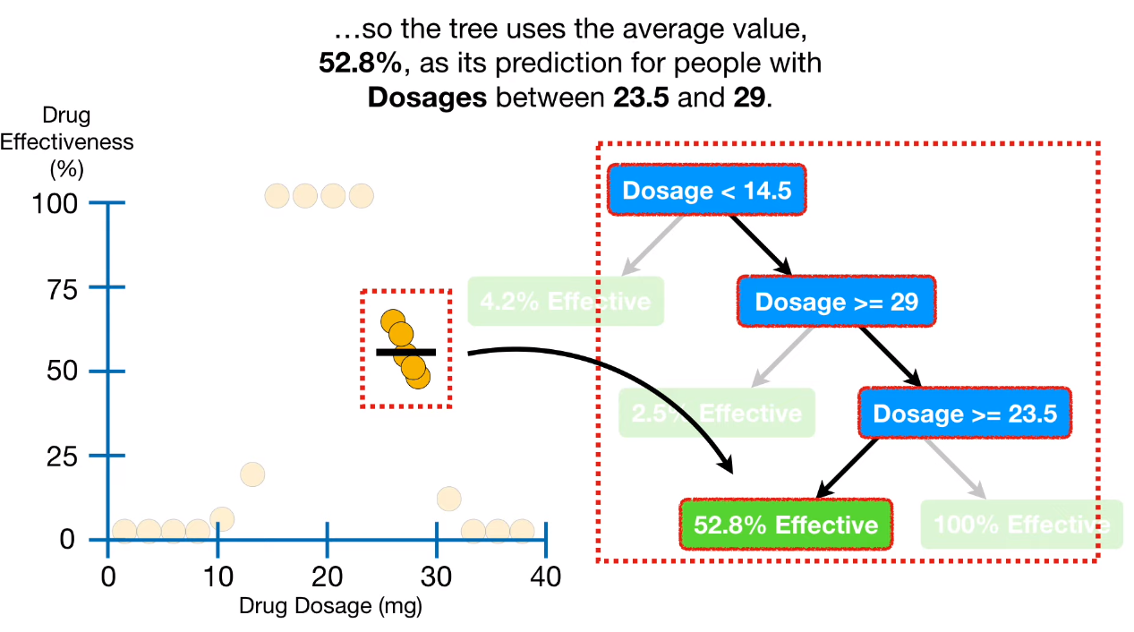
Decision Tree Regression

Slide 52
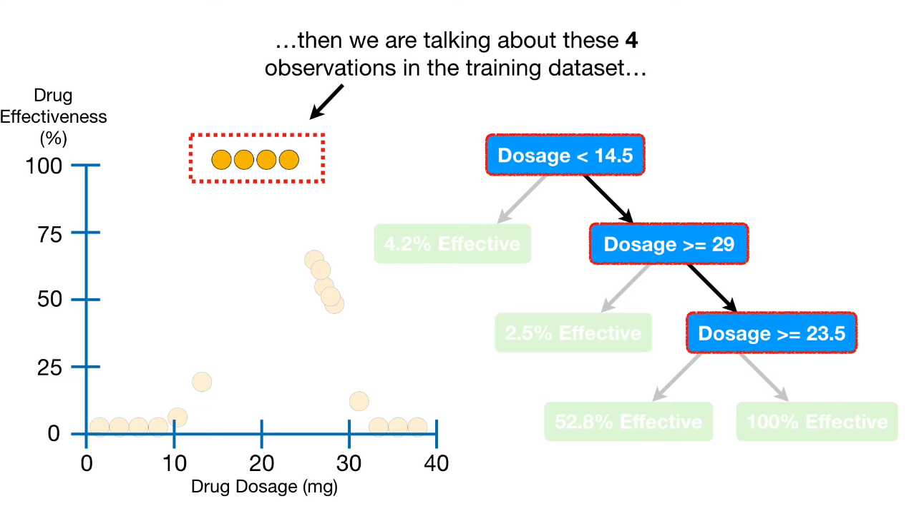
Decision Tree Regression

Slide 53
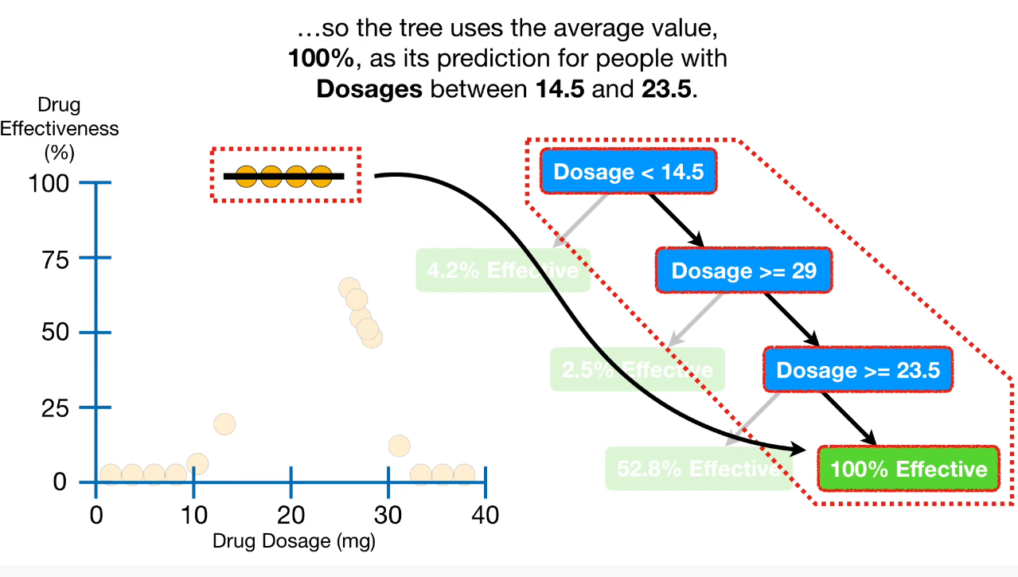
Decision Tree Regression

Slide 54
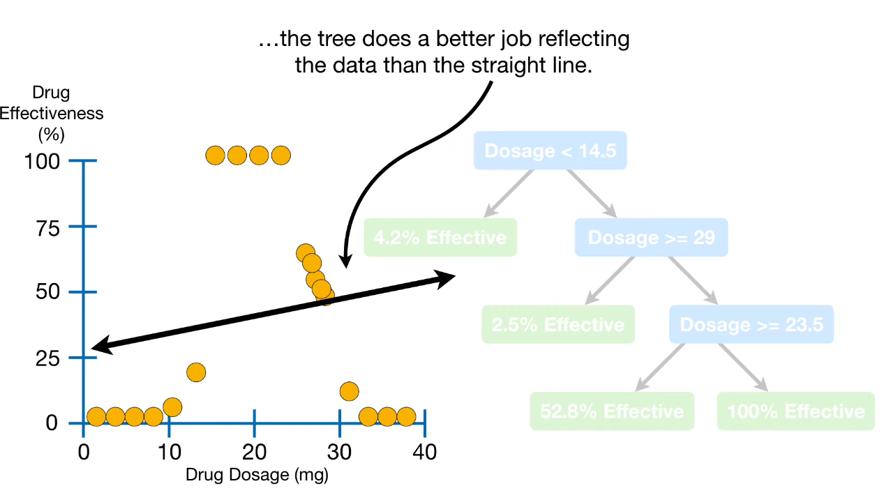
Decision Tree Regression

Slide 55
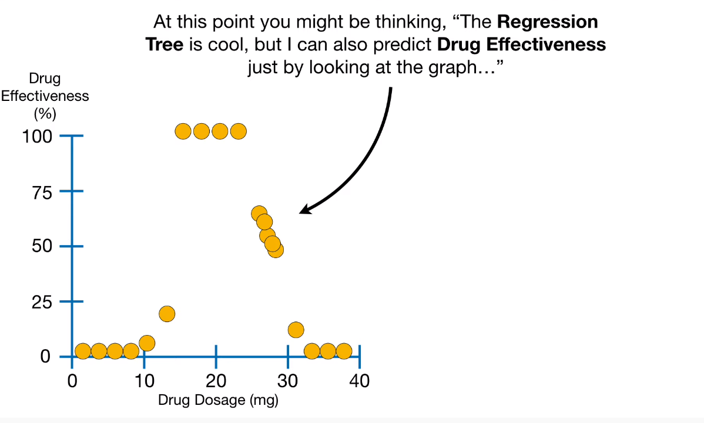
Decision Tree Regression

Slide 56

Decision Tree Regression

Slide 57

Decision Tree Regression

Slide 58

Decision Tree Regression

Slide 59

Decision Tree Regression

Slide 60

Decision Tree Regression

Slide 61

Decision Tree Regression

Slide 62

Decision Tree Regression

Slide 63

Decision Tree Regression

Slide 64

Decision Tree Regression

Slide 65

Decision Tree Regression

Slide 66

Decision Tree Regression

Slide 67

Decision Tree Regression

Slide 68

Decision Tree Regression

Slide 69

Decision Tree Regression

Slide 70

Decision Tree Regression

Slide 71

Decision Tree Regression

Slide 72

Decision Tree Regression

Slide 73

Decision Tree Regression

Slide 74

Decision Tree Regression

Slide 75

Decision Tree Regression

Slide 76

Decision Tree Regression

Slide 77

Decision Tree Regression

Slide 78

Decision Tree Regression

Slide 79

Decision Tree Regression

Slide 80

Decision Tree Regression

Slide 81

Decision Tree Regression

Slide 82

Decision Tree Regression

Slide 83

Decision Tree Regression

Slide 84

Decision Tree Regression

Slide 85

Decision Tree Regression

Slide 86

Decision Tree Regression

Slide 87

Decision Tree Regression

Slide 88

Decision Tree Regression

Slide 89

Decision Tree Regression

Slide 90

Decision Tree Regression

Slide 91

Decision Tree Regression

Slide 92

Decision Tree Regression

Slide 93

Decision Tree Regression

Slide 94

Decision Tree Regression

Slide 95

Decision Tree Regression

Slide 96

Decision Tree Regression

Slide 97

Decision Tree Regression

Slide 98

Decision Tree Regression

Slide 99

Decision Tree Regression

Slide 100

Decision Tree Regression

Slide 101

Decision Tree Regression

Slide 102

Decision Tree Regression

Slide 103

Decision Tree Regression

Slide 104

Decision Tree Regression

Slide 105

Decision Tree Regression

Slide 106

Decision Tree Regression

Slide 107

Decision Tree Regression

Slide 108

Decision Tree Regression

Slide 109

Decision Tree Regression

Slide 110

Decision Tree Regression

Slide 111

Decision Tree Regression

Slide 112

Decision Tree Regression

Slide 113

Decision Tree Regression

Slide 114

Decision Tree Regression

Slide 115

Decision Tree Regression

Slide 116

Decision Tree Regression

Slide 117

Decision Tree Regression

Slide 118

Decision Tree Regression

Slide 119

Decision Tree Regression

Slide 120

Decision Tree Regression

Slide 121

Decision Tree Regression

Slide 122

Decision Tree Regression

Slide 123

Decision Tree Regression

Slide 124

Decision Tree Regression

Slide 125

Decision Tree Regression

Slide 126

Decision Tree Regression

Slide 127

Decision Tree Regression

Slide 128

Decision Tree Regression

Slide 129

Decision Tree Regression

Slide 130

Decision Tree Regression

Slide 131

Decision Tree Regression

Slide 132

Decision Tree Regression

Slide 133

Decision Tree Regression

Slide 134

Decision Tree Regression

Slide 135

Decision Tree Regression

Slide 136

Decision Tree Regression

Slide 137
Problems of decision tree
Decision trees can not easily capture additive structure
For example, as seen on next slide on the left, a simple decision boundary of the form x1 + x2 could only be approximately modeled through the use of many splits, as each split can only consider one of x1 or x2 at a time
A linear model on the other hand could directly derive this boundary, as shown below right
Over fit is a terrible and common issue!!
We will discuss how to fix that in the next lectures

Slide 138

Problems of decision tree

